Slide 1
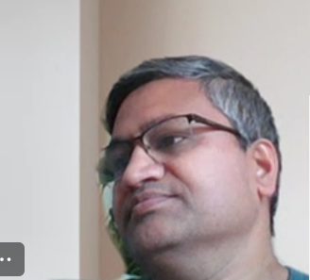
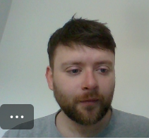
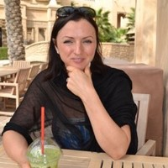
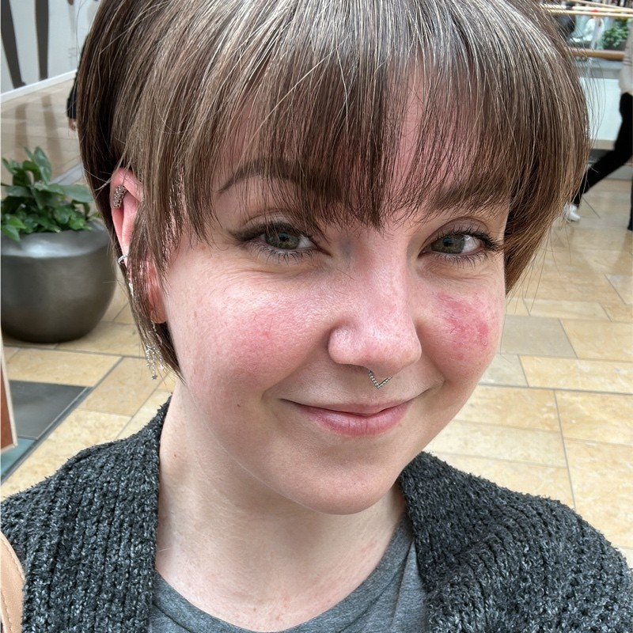
Our Team: PALS
Praveen Karnam
Andrew Rennie
Lorna Gordon Smith
Suzy Brown
LBG
Software Engineer
LBG
Software Engineer
LBG
Software Engineer
LBG
Software Engineer
Notes:
Intro: Suzy
Hi everyone, Happy Friday afternoon! Most of you know me: I’m Suzy – I’m the S in PALS! Here’s some lovely pics of our little mugs so you know who we are! We’ve got P for Praveen, A for Andrew, L for Lorna and S for Suzy to round off the bunch! It’s simple but more exciting than Project Group 1!
I’ve loved seeing everyone else’s presentations & demos – it’s been super interesting seeing different visions of the same brief come to life!
Just a quick reassurance: it’s not going to be death by PowerPoint! Andrew & I are going to take you through a handful of slides covering timeline and overview for our project and then we’ll hand over to Lorna and Praveen to give a quick demo. We’ll have time for questions at so if you do have anything you want to ask, pop it in the chat and we’ll come back to it at the end.
Kicking straight off…

Slide 2
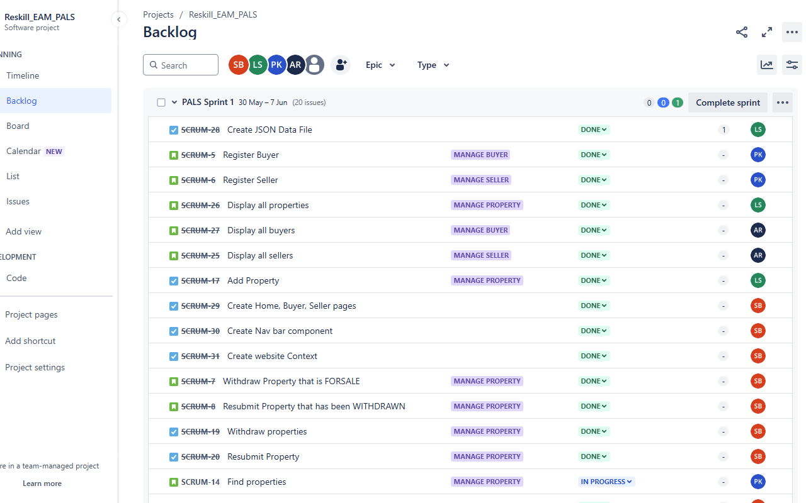
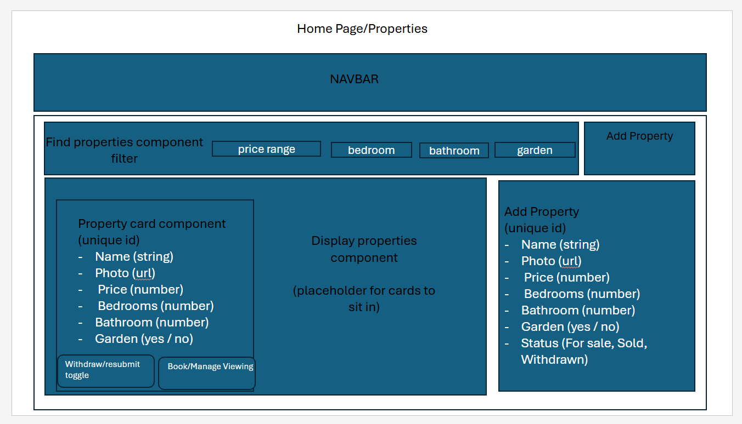
AGILE & SCRUM LEARNING
TECHNICAL LEARNING
PROJECT/SPRINT PLANNING
REFINEMENT
SPRINT REVIEW/
PRESENTATION
PROJECT 0
PROJECT 1 START
SPRINT ACTIVITY
MINI-SPRINT 2
We took some time to understand the project as a group
Explored how we would deliver depth of value to the customer by writing user stories on Jira
Created placeholder tasks which would enable the required functionality to be built
Notes:
Slide 1: Suzy
Throughout Projects 0 and 1 (and can I just say - a fitting naming convention – did an engineer come up with that?!) we took a really agile approach to working together. Project 0 covered off writing up our User Stories onto a JIRA board. Having never used JIRA before this was like a shock to the system for me! Without knowing the stack of tech we’d be using for the project, we kept our tasks & stories open so they would still be applicable. We broke down the key features – Buyers, Sellers, Properties and Bookings – and got all our placeholders tasks onto the board.
I’ve put a couple of snips on here from some of the planning documents we used along the way, so you can see our JIRA board on the left and our wire-frame on the right.

Slide 3
AGILE & SCRUM LEARNING
TECHNICAL LEARNING
PROJECT/SPRINT PLANNING
REFINEMENT
SPRINT REVIEW/
PRESENTATION
PROJECT 0
PROJECT 1 START
SPRINT ACTIVITY
MINI-SPRINT 2
Created a wire-frame to identify the individual components required and general page layout
We revisited our Jira board, aligning these newly identified components with our tasks
We set a sprint goal - 'Deliver MVP functionality by the end of the sprint'
Moved MVP tasks into the sprint backlog and ordered them logically in the order of the build
We wanted to be truly agile and left tasks unassigned, ready to be picked up and worked in order of availability
Committed to holding daily stand ups, end of day meetings, merging branches on GitHub as a team when key features were delivered, and to hold a backlog refinement session at the sprint midpoint
Notes:
Slide 2:
Moving into Project 1, we held a main planning session where, as a group, we reviewed the tasks on JIRA and agreed rough approaches to some of the elements of the brief. We wire-framed out our initial draft and from there looked at what made sense chronologically. So we started with the foundations like your home page, your sellers page etc – all the spaces that our components were going to be sitting inside. When you strip back to the bare bones & wire framing, it became a lot easier to see how each part of our project would need to be built. For example the Navbar would need to sit at the uppermost level because that needs to be displayed everywhere – that kind of rational approach. We undertook two mini-sprints throughout this project. The main goal we set ourselves during sprint 1 was to deliver the MVP. What did we *need* to achieve & deliver in order to meet the requirements of the brief? We moved everything that made up MVP into our sprint backlog and only picked up a task each to start with. We really wanted to embody the agile mindset so picked up tasks up as we were going based on the project’s need.
We held daily stand ups and end of day meetings to ensure performance against our main sprint one goal was shared. When it came to things like merging branches on GitHub, we held ad-hoc team calls when key features were delivered (four pairs of eyes are definitely better than one!). We held a backlog refinement session at the sprint midpoint – so towards the end of sprint 1 – so that we could review what we’d produced – does that fit the requirements of the MVP in the brief, work out any bugs and agree steps moving forwards. Andrew is going to take you through the second half of the week, so I’ll hand you over to him!

Slide 4
AGILE & SCRUM LEARNING
TECHNICAL LEARNING
PROJECT/SPRINT PLANNING
REFINEMENT
SPRINT REVIEW/
PRESENTATION
PROJECT 0
PROJECT 1 START
SPRINT ACTIVITY
MINI-SPRINT 2
We used daily stand ups to inform the team of our focus and aims for the day ahead, and raise any concerns or bugs we'd identified
We tried different development approaches during the sprint, including paired programming
We worked together, flexibly as a team to troubleshoot issues by using group Teams calls
When merging branches, we tested the functionality of and compatibility of the components together
We used end of day meetings to provide updates on our progress and identify any additional areas requiring particular attention the following day

Slide 5
AGILE & SCRUM LEARNING
TECHNICAL LEARNING
PROJECT/SPRINT PLANNING
REFINEMENT
SPRINT REVIEW/
PRESENTATION
PROJECT 0
PROJECT 1 START
SPRINT ACTIVITY
MINI-SPRINT 2
Our refinement session was held at the sprint midpoint, where we were on the verge of delivering MVP functionality
We decided to treat the remainder of the sprint as a mini-sprint and focussed on more detailed replanning
We further broke down the tasks outstanding in the project backlog so that they became more manageable and moved these into the sprint – including non-MVP features
We held a mini retro to discuss what we could do differently as we moved into the mini-sprint
Having trialled paired programming and seeing the benefits, we agreed on this being the approach for the mini-sprint
We also used the retro as an opportunity to highlight what other aspects had led to our success so far and the importance of maintaining these
...AND NOW ON TO THE DEMO!

Slide 6
What did we learn from the project? Q&A

